Slide 1

ANALYSIS OF COST-EFFECTIVE INFLUENCE MAXIMIZATION STRATEGIES ON TEMPORAL NETWORKS

Slide 2
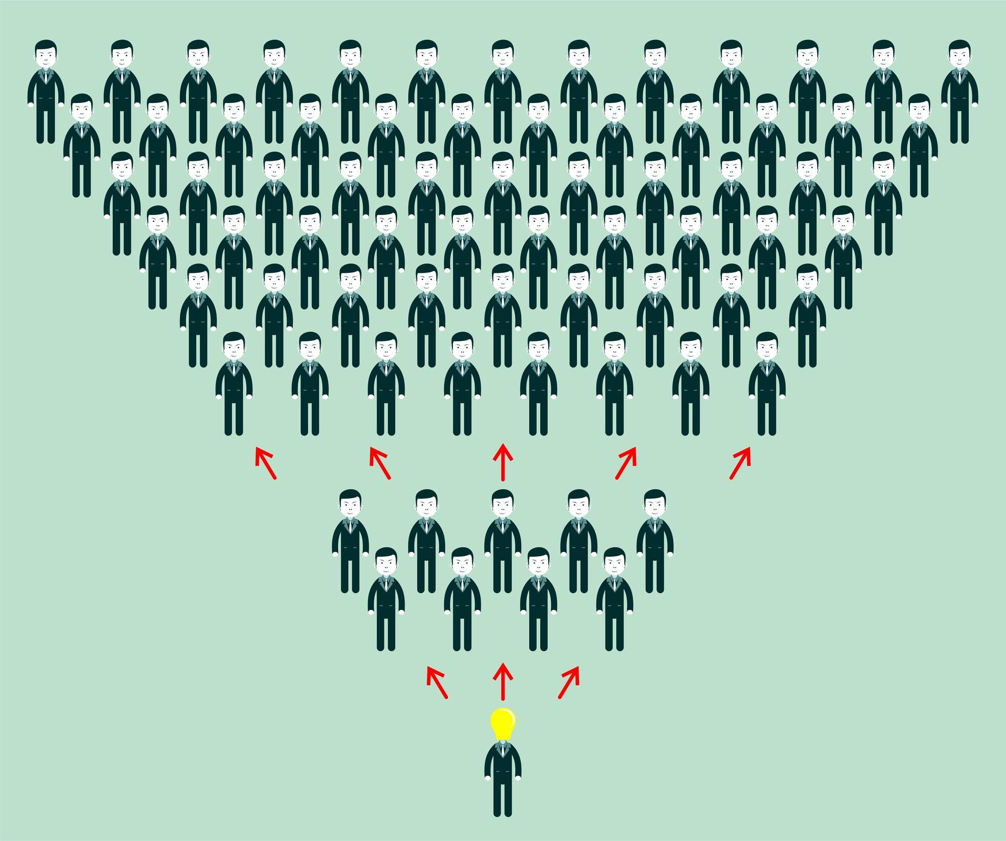
The Influence Maximization Problem
Influence Maximization is an algorithmic problem where the goal is to find a subset of nodes, called Seed Set, that can maximize the spreading of a certain influence across some complex network.

Slide 3
The Importance of Influence Maximization
Nearly everything we deal with nowadays is shaped as a complex network:
Blood System and Brain
Transport Infrastructures
Water Distribution
Internet and Social Media
And much more. Acquiring knowledge about the structure of complex networks and solving problems related to them is essential.

Slide 4
Influence Maximization Applications
Various range of practical implications in many disciplines, such as:
VIRAL MARKETING product advertising | SOCIETY outbreak detection and epidemics spread | COMPUTER SCIENCE fake news epidemics and rumors spread
Modern day social media enhance these correlations even more

Slide 5
Viral Marketing Application Example in Social Media
The goal is to maximize the interest towards a product by selecting some influential users for its endorsement and advertising.
Select best possible initial nodes, so that the interest towards the product is massively shared through their network of contacts or followers
Seed nodes share the influence and the next influenced nodes do the same on their own network of contacts
Influence stops when there are no more contacts, a lot of nodes have been reached and hopefully the majority of them is influenced and therefore interest in the advertised product

Slide 6
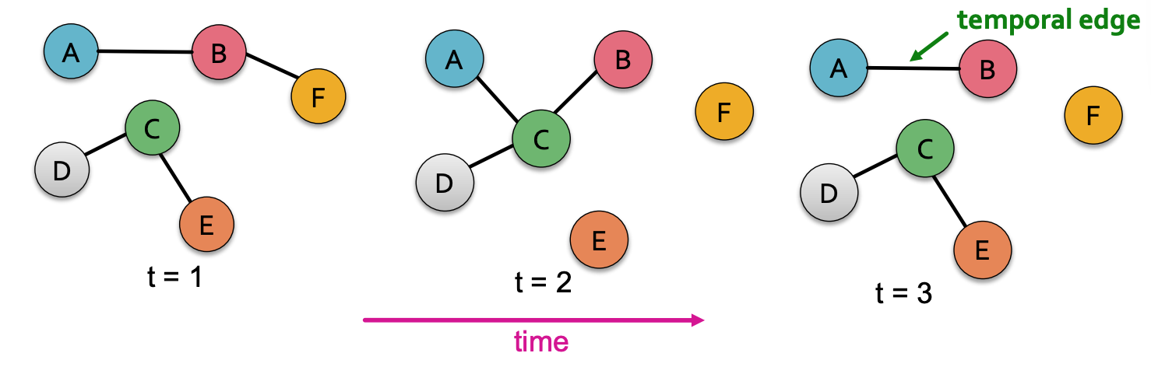
Temporal Networks
Any spreading process occurs over time, and the latter highly characterizes that process. This work is based on temporal networks since also social interactions do not happen all simultaneously, and new interactions can arise and vanish over time.

Slide 7
Seeding
CLASSIC IM FRAMEWORK Restrict Seed Set Cardinality Freedom of Node Choice | PROPOSED IM FRAMEWORK Restricted Budget Cap Cost of Node Seeding
c(n) = e^{𝛅(n)} , where c(n) is the cost of node n, and 𝛅(n) its degree.

Slide 8
Optimal Solutions in Large Scale Networks
Greedy approach, adding one node at a time
Best Contributing node is chosen
NP Hard, not applicable to Large Scale Networks
Full Network Knowledge

Slide 9
Sub-Optimal Solutions
Greedy approach, adding one node at a time
Best EDV node is chosen
Applicable to Large Scale Networks
Full Network Knowledge useful, but not essential for each of these solutions

Slide 10
Proposed Sub-Optimal Solutions
The range of Sub-Optimal Solutions is very wide, with each of them being characterized by a different estimation of the EDV, that can be time-related or not. The proposed EDVs for the different strategies are:
Node’s degree (HDN) or cheapest neighbor (HDCN)
Node’s earliest interaction in the network window (EN)
Node’s cascade cover (MC)
Node’s difficulty to be reached (UDON) (UTON)

Slide 11
Goal(s) Of This Work
Presenting a new, more realistic Influence Maximization Framework that can suit large scale networks
Coding the base structure and the tools to perform the analysis
Develop strategies and test their performance on realistic datasets
Collect results data and draw conclusions

Slide 12
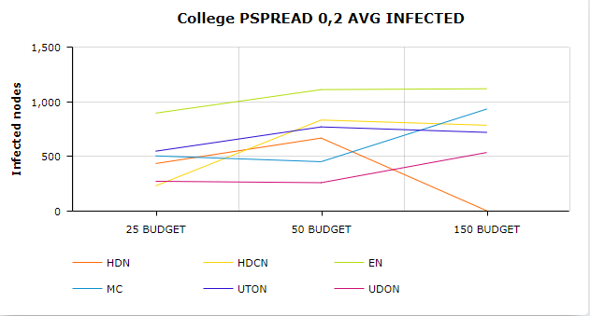
Dataset 1 Performance Results

Slide 13
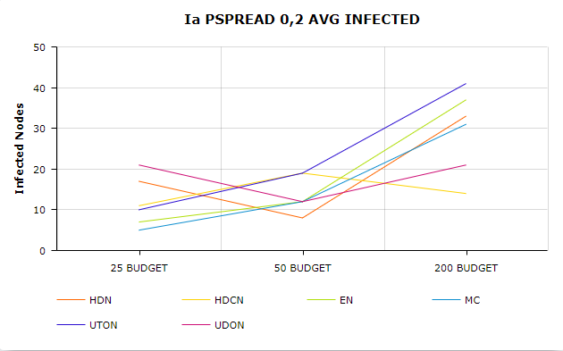
Dataset 2 Performance Results

Slide 14
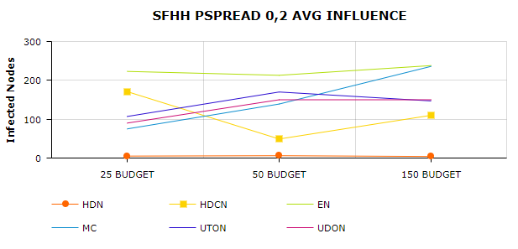
Dataset 3 Performance Results

Slide 15
Considerations
What the results tell us
Temporal Networks have huge impact on the outcome of every spreading process, and cannot be treated like static networks when considering sub-optimal solutions.
Seeding restrictions limit the overall performance, but allow a more realistic scenario.
Proposed Sub-Optimal solutions guarantee good results, but their performance highly depends on the network structure.

